Slide 1



Building Momentum in Academic Affairs
Academic Affairs Fall Address
September 8, 2023
Joshua Powers, Provost
Anthony Bowrin, Dean CCOB
Venkat Sharma, Dean COSH
Wartyna Davis, Dean CAHSS
Amy Ginsberg, Dean, COE

Slide 2

Standing on our Colleague’s Shoulders
Faculty and Staff Retirees in Academic Affairs
Alejandro Anreus | Erh-Wen Hu | Mary Malu | Bogong Su
Julie Bliss | Barbara Kushner | Maureen Martin | Karen Swanson
Patricia Grosso | Claire Leonard | Lillian Prince | He Zhang

Slide 3

Welcoming our New Colleagues
New Faculty & Staff to Academic Affairs
Jamel Adkins-Sharif | Carlee Denholtz | Keisha Newell | Latifa Sebti
Dyonne Bennett | William Ernst | Karen Orland | Iryna Surmachevska
Nasim Bibi | Juleisy Del Carmen Gomez | Janet Lynn Regan-Livingston | Alfred Verrios
Cassandra Carrie Carleton | Scott Greenberg | Ali Mohammad Saghiri | Nan Wang
Lama Chaddad | Minerva Guttman | Mourad Sarrouti | Jameelah Wright
Grace Clark | Jemour Maddux | Nishikant Satam

Slide 4

Celebrating Our Faculty Colleague’s Achievements
Faculty Tenured
Abdelrahman Elleithy
Laura Di summa Knoop
Samuel Fancera
Christopher Herbert
Gary Marks
Julie Nagle
Saeed Shekari
Aileen Torres
Faculty Promotions
Bahar Ashnai
Corrine Datchi
Peter McGuinness
Kiho Lim

Slide 5


A William Paterson Momentum Moment for the Ages
Governor Murphy’s comment to President Helldobler the next day:
“There were two moments I will always remember. The first is all of the first generation college students who stood when you invited them to do so. The second was the extraordinary story told by your student speaker.”
“I am living testimony that if given just an ounce of opportunity, you can do anything.”
-Racha Ahmad
https://www.youtube.com/watch?v=uxEosrm5PDk

Slide 6
The Foundations of Momentum:
Chronicle of Higher Education Almanacs 2019 & 2023
NJ Statistic | 2019 | 2023 | Import
15-24 year old population | 1,143,717 | 1,139,857 | Already seeing shrinking pool of traditional aged students (-3,860) and demographic “cliff” still looming.
25-44 year old population | 2,323,457 | 2,409,454 | Growth in adults as potential college students (+85,997).
% White population | 67.9% | 54.6% | The future is today and it is black and brown.
Prop. who speak a language other than English at home | 31.8% | 31.7% | NJ is #3 behind only CA (43.9%) & TX (34.9%).
Avg. Tuition & Fees at 4yr publics | $13,862 | $15,089 | Tuition up 8.9%, CPI over same period up 16%. Value proposition for choosing school over work getting harder.
No. of 4yr private non-profit institutions | 31 | 42 | Opportunity is here, and new entrants see it.

Slide 7
The Pillars of Momentum
1: Activities | 2: Activities | 3: Activities | 4: Activities
Navigate | 19 active Certs. 17 at Senate | WP Online UG growth: 0-X | UCC Social Justice Certificate
Faculty as Mentor | New curriculum workflow | Transfer Credit growth: +19,232 since ‘20; CPL growth: +749 since ‘20 | Pre & Post-Doc Fellows
Free/Reduced cost materials | Website for Certs & Badging system | SCPE in support of this future | Grants in support

Slide 8

Branding Momentum
Student Success Teams for each on-campus undergraduate (launched and developing).
Students earn a certificate in the first two years of their studies (new certificates approved and others in pipeline).
UCC discussion on social mobility and outcomes that employers seek (faculty engagement 2023-24).
Career skills mapping to courses and curriculum (faculty engagement 2023-24).
WP serving the health care needs of the state (launched School of Nursing & exploring capacity building in allied health areas).
WP serving stop out-returner student needs of the state (continued growth of WP Online and 2023-24 exploration of main campus alignment with working student needs – NSSE Results informing).

Slide 9

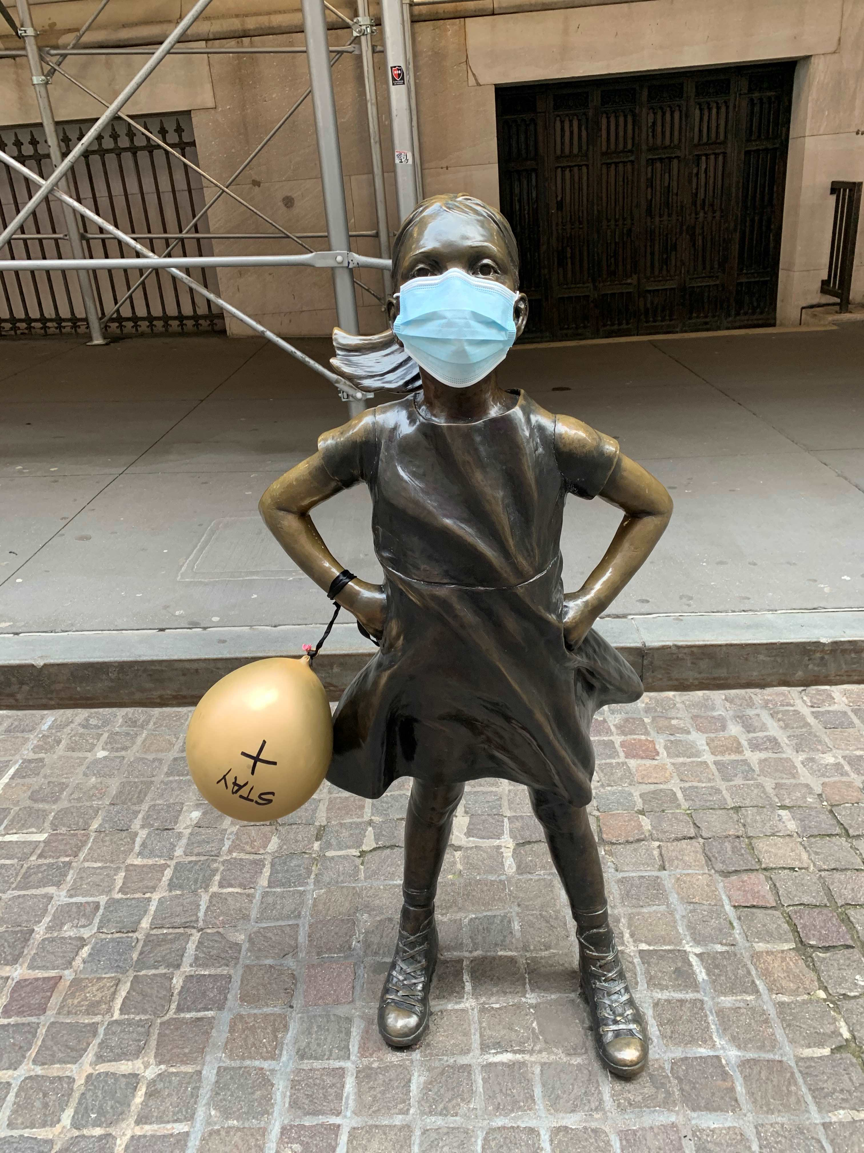
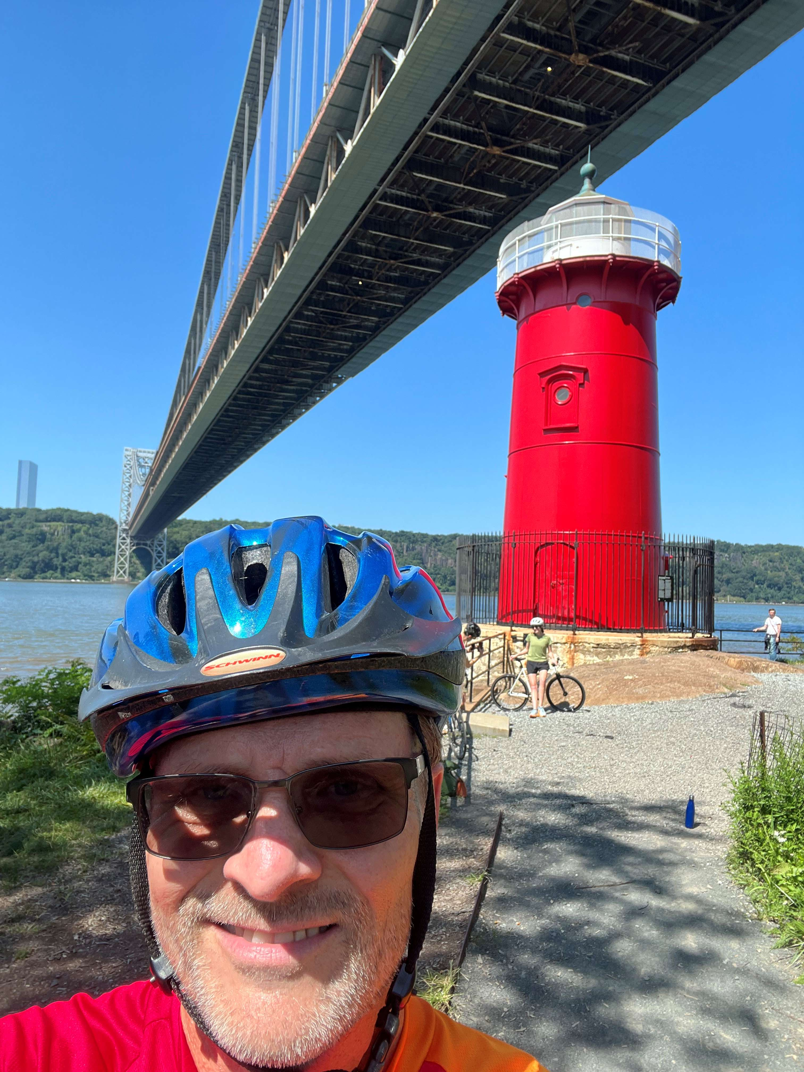
Exploiting Who We are for Momentum…
5 Academic Affairs Goals:
Grow enrollment
Help students succeed
Be good stewards of resources
Generate alternative revenues
Invest in people
We are scrappy, determined, and a beacon, second to no one!

Slide 10
Aspects of Momentum
Finalization and implementation of CCOB Strategic Plan 2023-2026:
Professional Enhancement Program (PE), and Career Outlook and Industry Networking (COIN) - Linking Academics and Career Development
Certificates within first 60 Credits of degree programs
Credit-for-Prior-Learning - Adult learners
Faculty Summer Research Forum - Investing in our People
Cotsakos College of Business

Slide 11
Linking Academics and Career Development
Professional Enhancement Program (PE)
Goals - Successfully transition students into WP; have them develop a sense of belonging at WP; and enhance their readiness for the next stage of their careers at graduation.
Status - Fall 2022 Cohort of FTFT Freshmen in year 2 of program; Fall 2023 FTFT Freshmen in year 1; Integrated PE requirements in core business courses.
Career Outlook and Industry Networking (COIN)
COIN 2022 - 12 Sessions; 566 Student Participants (371 unique students); 2021 (166).
  - $30,000+ awarded in scholarships (20 students)
COIN 2023 - October 23-26, 2023
Cotsakos College of Business

Slide 12
Alternative Credentials and Certificates
Support for Adult Learners
Certificate within first 60 Credits of degree programs
Beginning fall 2023most CCOB majors can complete at least one Industry Valued Certificate within the first 60 credits of their degree program
Credit-for-Prior-Learning
  All three CCOB departments among the leaders at WP in evaluating and approving appropriate PL experiences for credit
Cotsakos College of Business

Slide 13
Investing in Faculty
Faculty Summer Research Forum
Prioritized support for faculty research and scholarship through the Summer 2023 Faculty Research Forum
11 projects focused on applied business research and/or pedagogy
16 unique CCOB faculty members from all three departments
Over $32K
Consistent level of support and faculty participation over the past 4 years
Cotsakos College of Business

Slide 14
COLLEGE OF SCIENCE AND HEALTH
Fall 2023 Re-Enrollment
 | Current Enrollment | Last Year Enrolled | YOY Change
 | 3707 | 3532 | +175 or +5.0%
Fall 2023 Enrollment Based on Power BI data obtained on September 5, 2023.
TEXT GOES HERE
COSH First Year Fulltime Freshmen Retention
COSH Majors | Retained | Retention Rate
286 | 211 | 73.8%
The FYFTF retention rate for COSH is 1.4% more than the overall FYFTF Retention rate at the university level.
Supplemental Instruction is mandatory in entry-level biology, chemistry, computer science, and mathematics courses required for STEM students. Data collected on SI and Peer Mentoring from these courses shows better student engagement and pass rates.

Slide 15

NURSING POWER
School of Nursing
Challenges & Opportunities
Achieve and Sustain high NCLEX pass rates
Automation of several processes
Partnerships with Health Care Industries
Received $1.25M Community Earmark Scholarship Program (CESP) – Congressionally Directed Awards for our Nursing Program

Slide 16

The CoSH Advisory Council has agreed to focus on FOUR target industries: Pharmaceutical, Healthcare, Technology/Cyber Security and Sustainability/Green Jobs. The goal is to engage alumni, friends, strategic corporate partners in each industry to join our network for excellence. Those in the network would be inclined to support student success and career readiness with their time, talent, or treasure. Since we hosted a successful healthcare panel last semester, this fall we will focus on the pharmaceutical industry and in April 2024 on the Technology/Cyber Security or Sustainability/Green Jobs Industries.

Slide 17


Creating an Inclusive and Supportive Online Learning Environment: 15 COSH faculty members benefitted from the professional development opportunity in Spring 2022.
Inspiring Inquiry and Preparing Lifelong Learners. 9 COSH faculty members benefitted from the professional development opportunity on Promoting Active Learning in Spring 2023.

Slide 18


Attrition
  ABC Campaign
  Pioneers and Leaders (PaLs)
  Financial aid Workshops
  Leave of Absence Follow-up
  AHSS Advise-a-thon
  Virtual Advisement (In-Person and Drop-In)
  Adjunct Workshops for High-Impact Courses
  In-Person and Virtual Town Halls
  Video Messaging
  Phone Campaign
  Student Leadership Council
  Outreach to students with financial holds

Slide 19
Decolonization (DEI)
Alternative Credentials & Certificates
    Leadership
    Podcasting
    Sports Journalism
    Filmmaking
    Writing for TV & Film
    Literature Studies
    Professional Writing
    Digital Storytelling
    Meditation & Mindfulness
    Spanish Bilingualism
    Digital Music
    Emergency Management
    Project Management
    Climate Change/Environmental Policy
    Forensic Psychology
    User Experience & Interface Design
  College provided safe space training for faculty and staff with more than 80 faculty and staff.
  Academic year 21-22
    All departments in the college held a workshop or brought in speaker regarding decolonizing our curriculum.
  Academic year 22-23
    Launched Ubuntu Fellows.
  Academic year 2023-24
    Continuing dialogues about the what and the how of what we do as faculty.

Slide 20
Free and reduced cost materials
Adult learners
Active in Wponline
Launched ground-breaking new major in Leadership and Professional Studies
COLLEGE | NO COST | LOW COST
College of Arts, Humanities, and Social Sciences | 247 | 141
College of Business | 36 | 9
College of Education | 15 | 7
College of Science and Health | 0 | 0
TOTAL | 298 | 157
Fall 2023, as of 05/25/2023

Slide 21
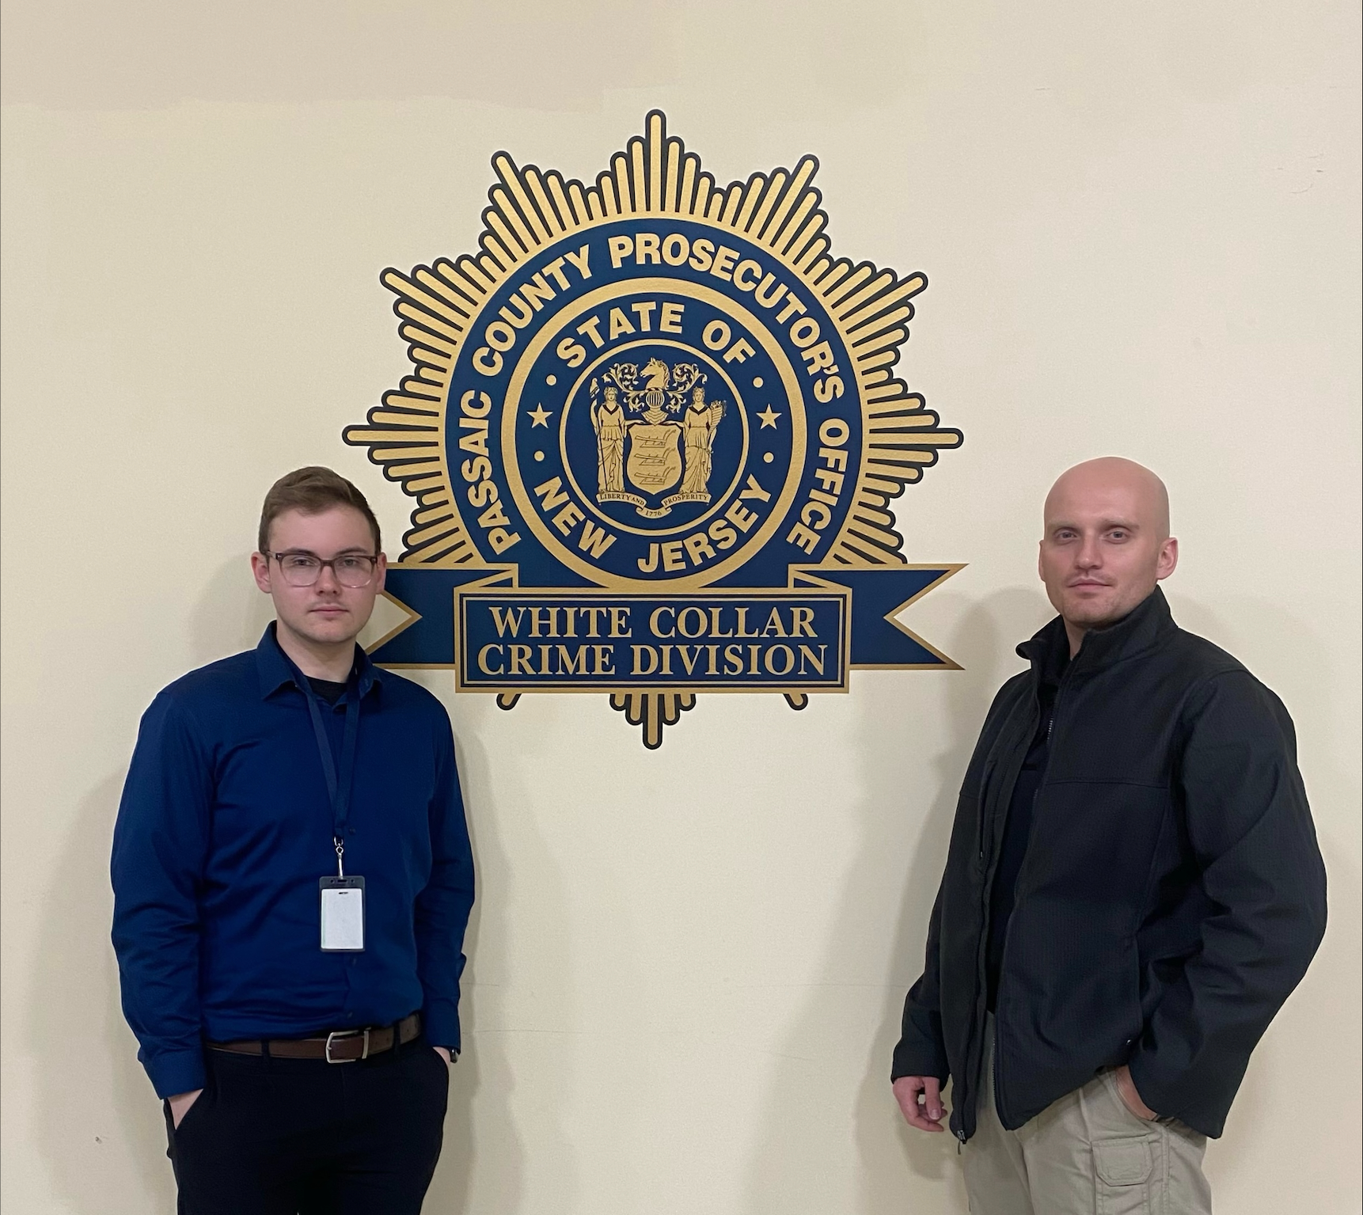
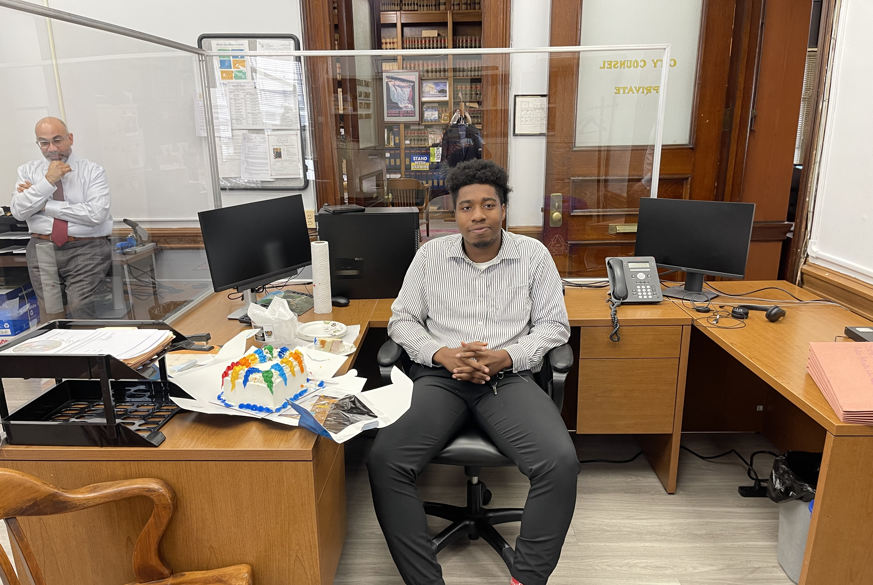
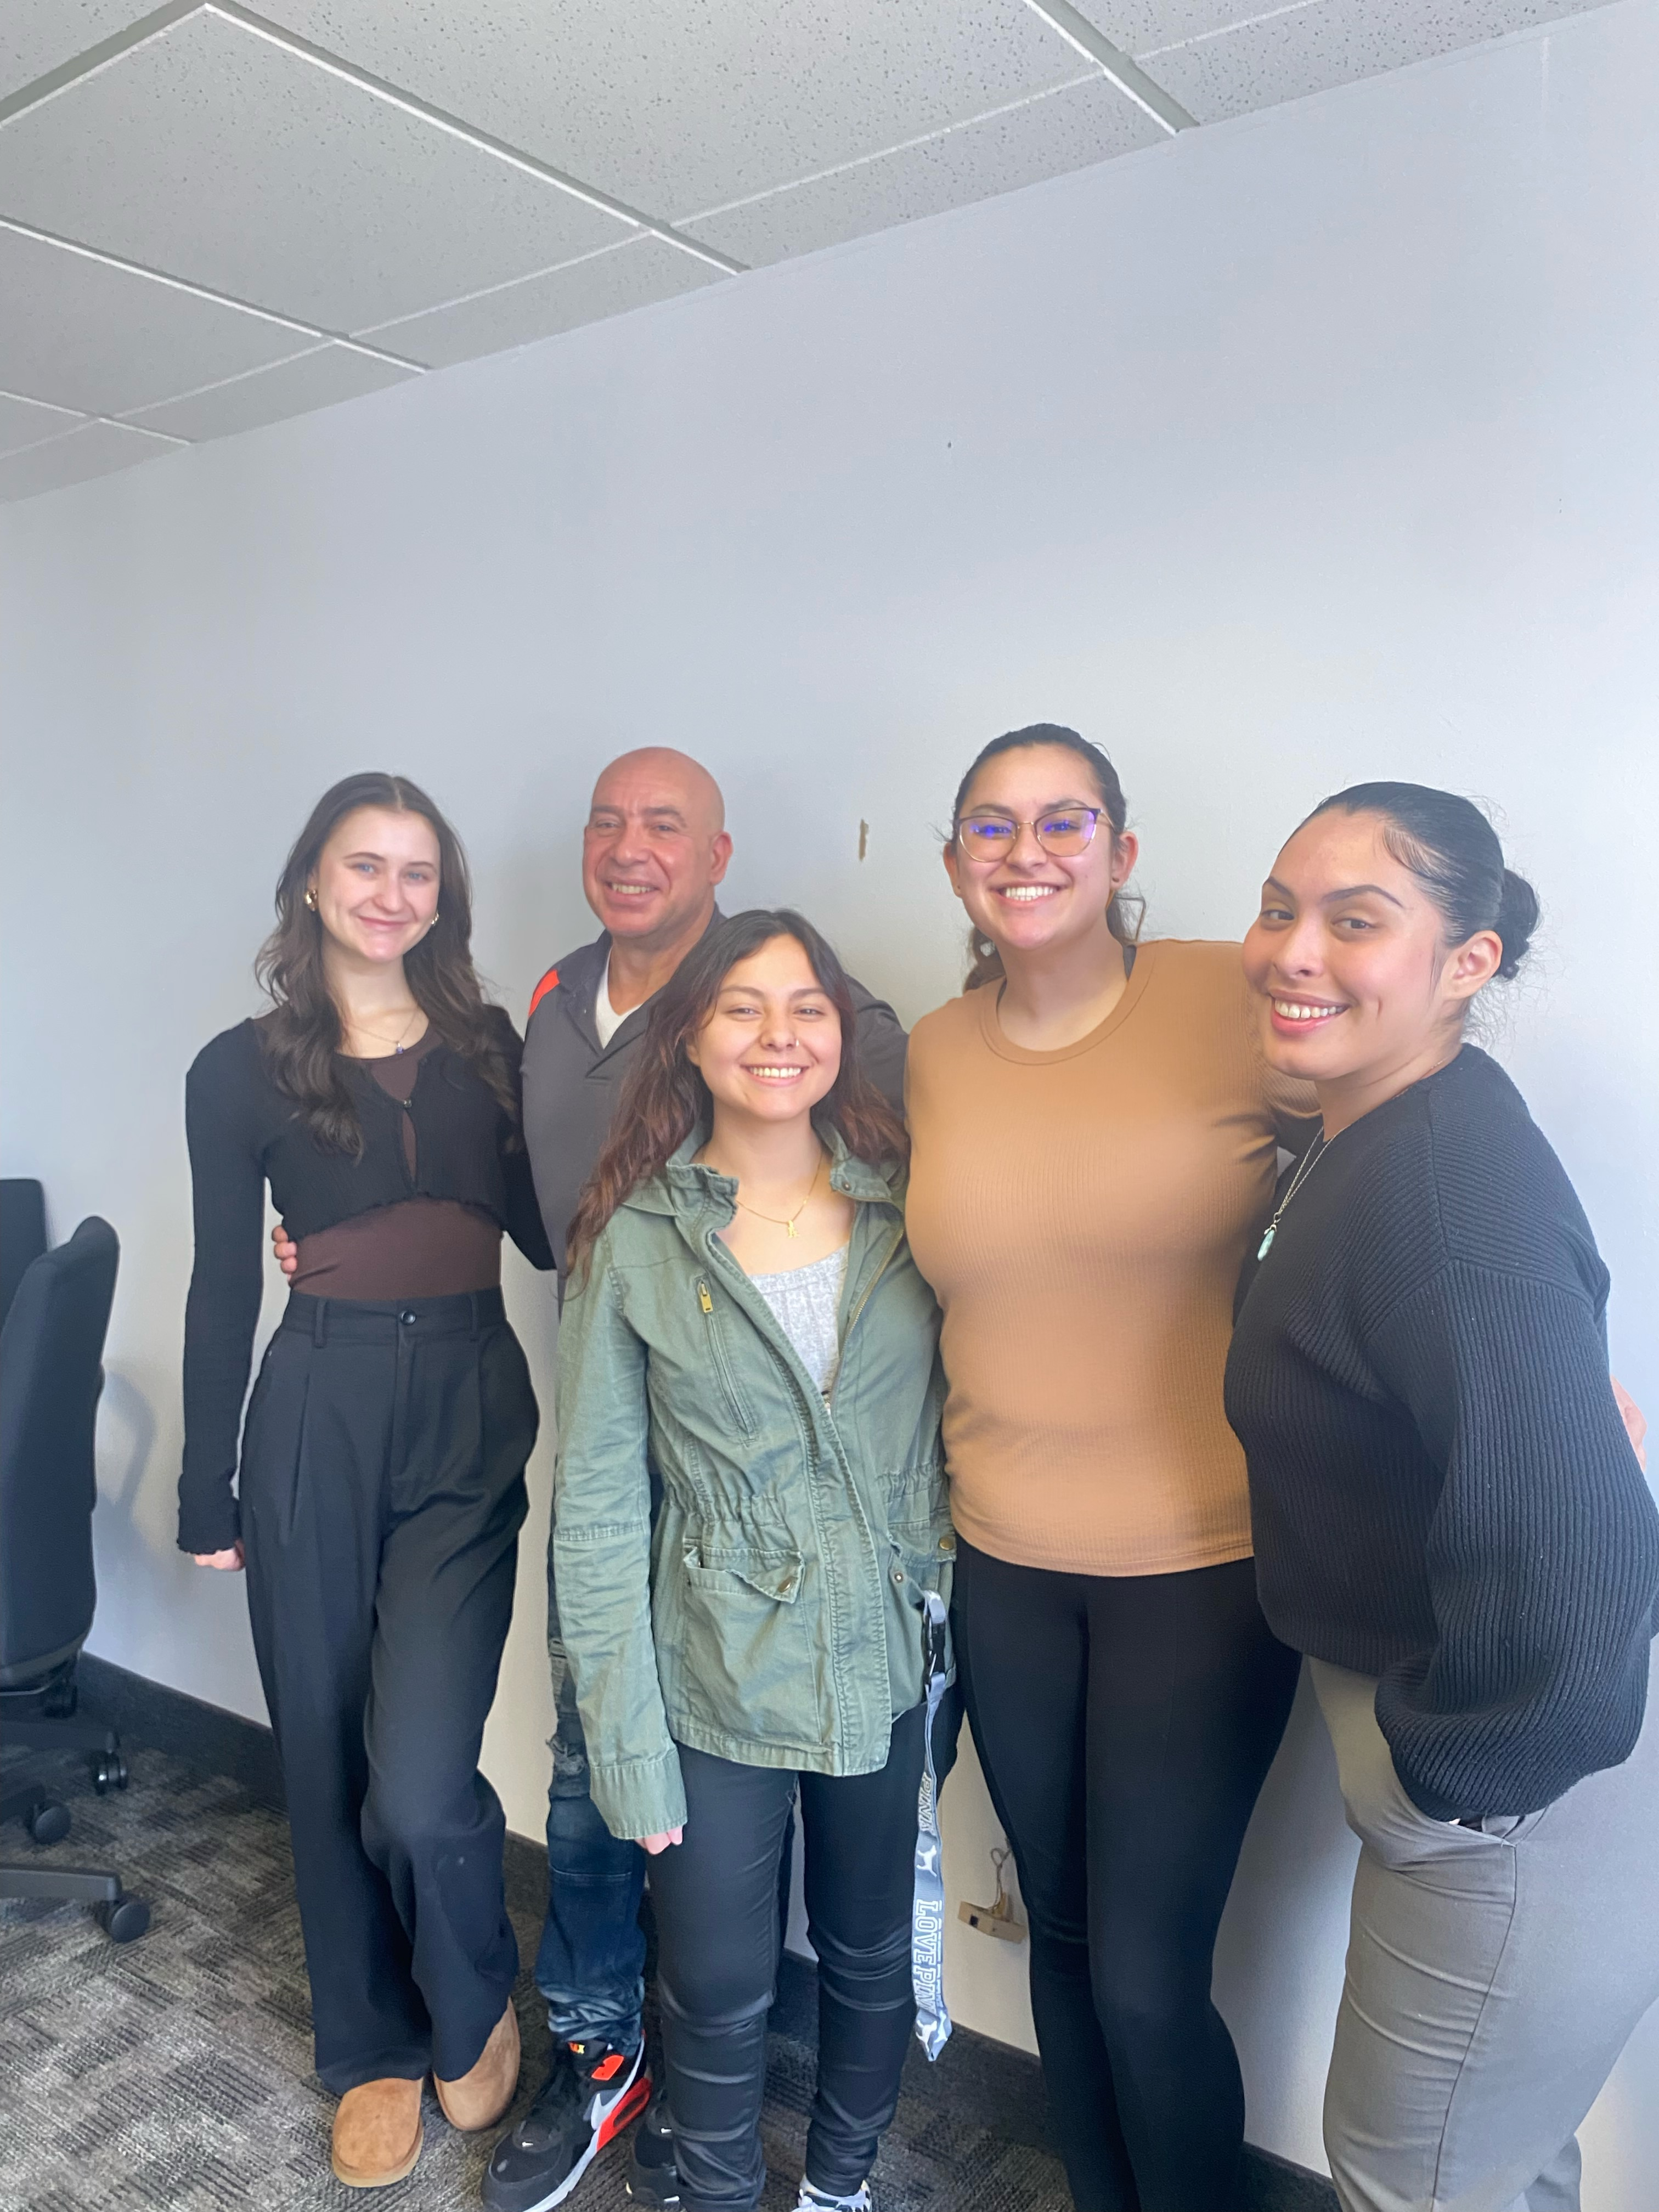
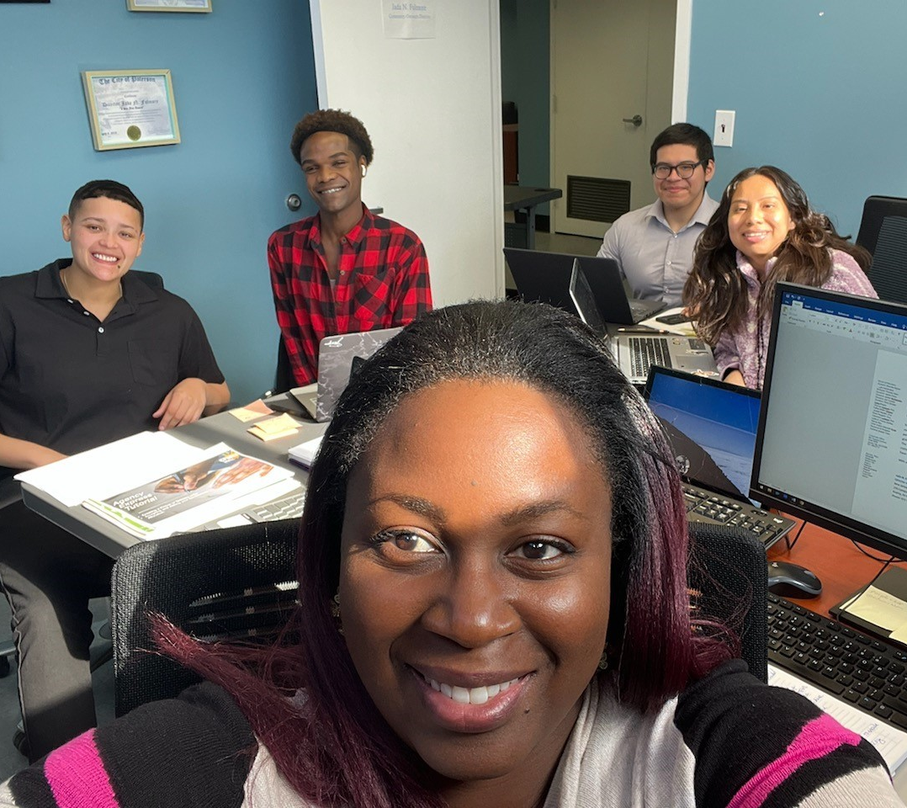
Linking Academic Affairs to Career Readiness
Aspire
Etiquette week with the College of Business
Centralized Internship coordination
Departmental career days

Slide 22

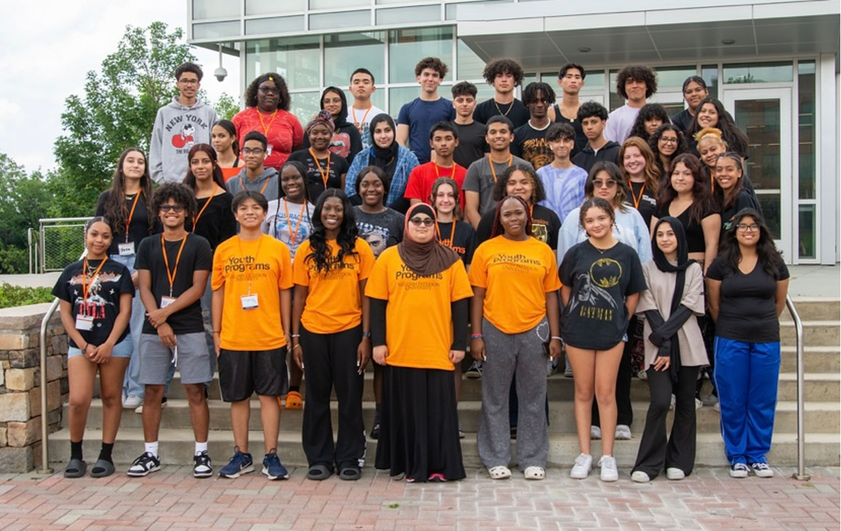
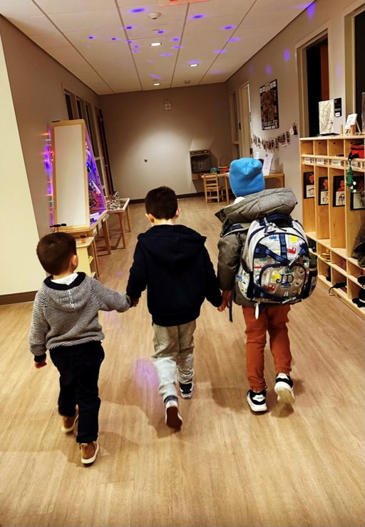
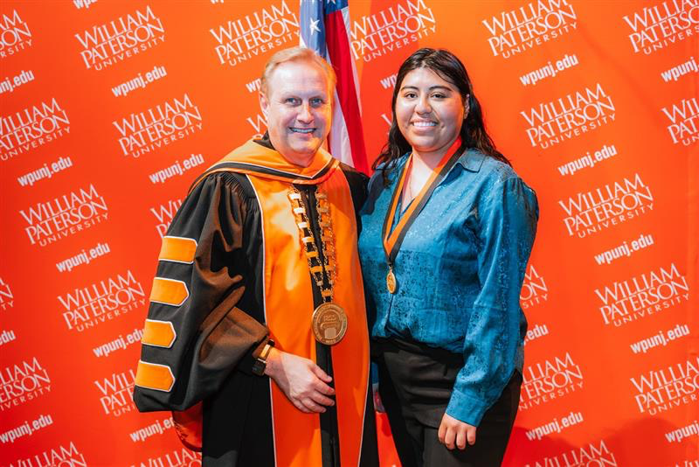

Slide 23
The COE Pillars of Momentum
I – Increase enrollment through aspiring educator/dual enrollment opportunities and the creation of apprenticeships with partner school districts.
2 - Decrease attrition through support for academic, financial, and well-being challenges.
3 – Offer alternative credentials that may build to an education degree and alternate route teacher certification programs that meet statewide demand.
4 – Appeal to adult learners with responsive programs, policies, and processes.
5 – Enact systemic change to address issues of diversity, equity, inclusion, and justice.

Slide 24
Centering Diversity, Equity, Inclusion, and Justice
Prioritizing Diverse Experiences & Perspectives
Child Development Center
Youth Programs – Transition Program
Pre-Doctoral Faculty Fellows in TEDU & SEPD
One-Year-Only Faculty in ELPS
Leadership Opportunities
Efforts to Diversify the Educator Workforce
Aspiring Educators
iTeach@WP
USED Hawkins Grant
NJDOE Minority Teacher Development Grant
Fall 2023 NJFEA Conference at WP

Slide 25
COE Systemic Commitment to Student Success
Enrollment Enhancement
Dual Enrollment
Aspiring Educators
Teacher Apprenticeships
Attrition Reduction
EDUC 2000
Praxis Support
iTeach @ WP
Case Management/Wrap-Around Support with Faculty Mentorship
Adult Learners
BA in Early Childhood Ed for Paras
WP Online Expansion
Collaboration with DCAL
Community College and Transfer Students
Alternative Credentials
Alternate Route Programs in P-3, K-6, K-12, ESL, and CTE
UG Cert in Schools and Communities
Non-cert BA pathway

